Slide 1

Foundations of Cryptography security guarantee, threat model, assumption, proof of security, finite probability, $K, M, C$
LiangFeng Zhang
zhanglf@shanghaitech.edu.cn

Slide 2
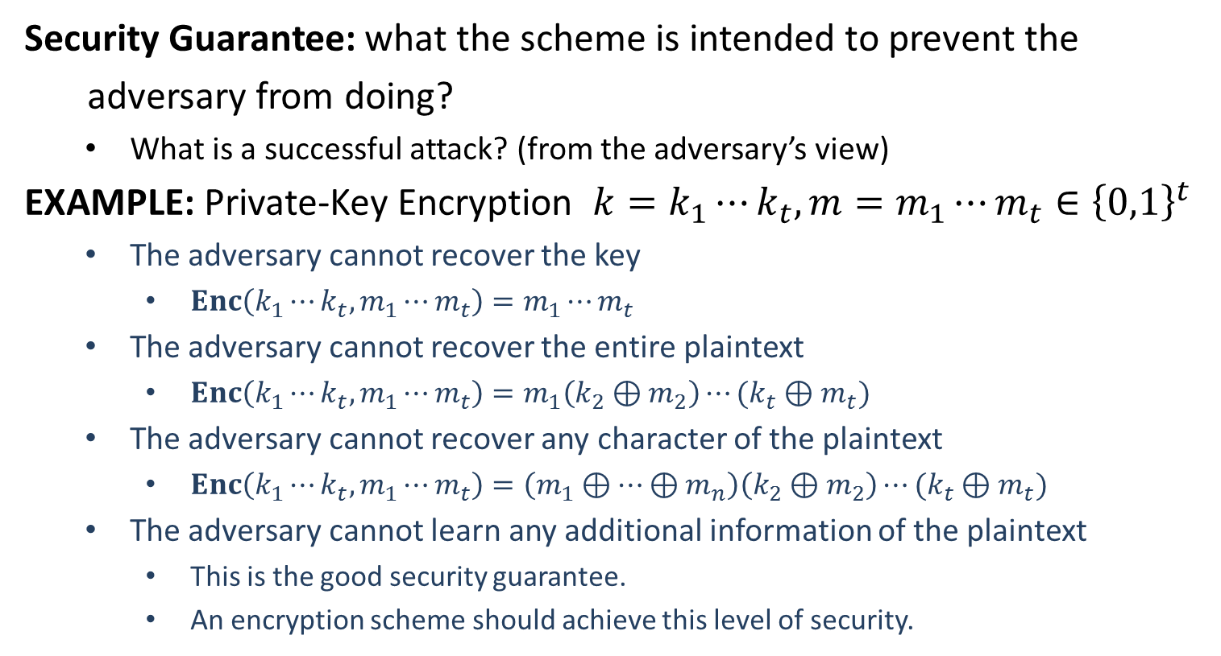
Formal Definitions (of Security)
Security Guarantee: what the scheme is intended to prevent the
adversary from doing?
What is a successful attack? (from the adversary’s view)
EXAMPLE: Private-Key Encryption $k=k_{1}⋯k_{t}, m=m_{1}⋯m_{t}∈{\left\{0,1\right\}}^{t}$
The adversary cannot recover the key
$Enc\left(k_{1}⋯k_{t},m_{1}⋯m_{t}\right)=m_{1}⋯m_{t}$
The adversary cannot recover the entire plaintext
$Enc\left(k_{1}⋯k_{t},m_{1}⋯m_{t}\right)=m_{1}\left(k_{2}⊕m_{2}\right)⋯(k_{t}⊕m_{t})$
The adversary cannot recover any character of the plaintext
$Enc\left(k_{1}⋯k_{t},m_{1}⋯m_{t}\right)=\left(m_{1}⊕⋯⊕m_{n}\right)\left(k_{2}⊕m_{2}\right)⋯(k_{t}⊕m_{t})$
The adversary cannot learn any additional information of the plaintext
This is the good security guarantee.
An encryption scheme should achieve this level of security.

Slide 3
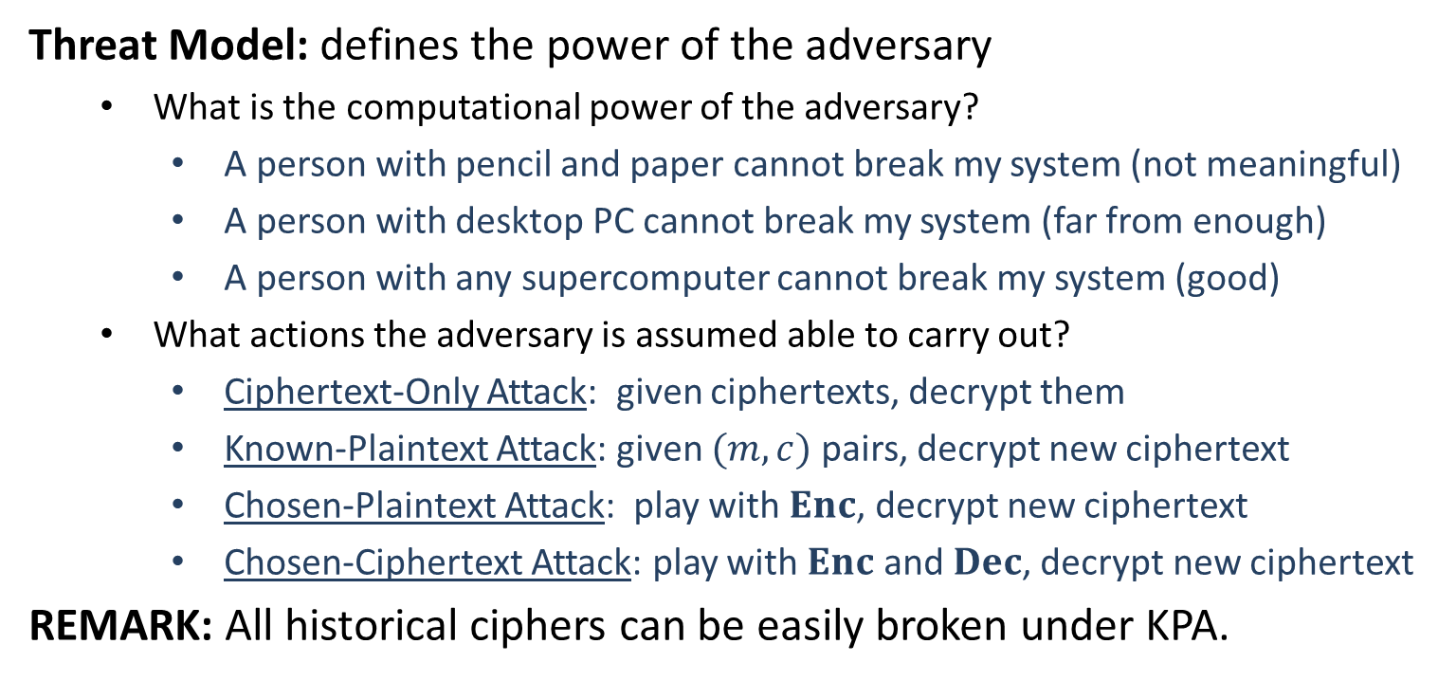
Formal Definitions (of Security)
Threat Model: defines the power of the adversary
What is the computational power of the adversary?
A person with pencil and paper cannot break my system (not meaningful)
A person with desktop PC cannot break my system (far from enough)
A person with any supercomputer cannot break my system (good)
What actions the adversary is assumed able to carry out?
Ciphertext-Only Attack: given ciphertexts, decrypt them
Known-Plaintext Attack: given $(m,c)$ pairs, decrypt new ciphertext
Chosen-Plaintext Attack: play with $Enc$, decrypt new ciphertext
Chosen-Ciphertext Attack: play with $Enc$ and $Dec$, decrypt new ciphertext
REMARK: All historical ciphers can be easily broken under KPA.

Slide 4
Precise Assumptions
Assumption: Statements that are not proven but conjectured to be true
EXAMPLE: Integer factoring is hard
Modern cryptographic constructions are based on assumptions
Why Precise Assumptions:
Not precise, cannot be studied well, cannot establish confidence
Facilitate the comparison of schemes with different assumptions
Understanding the necessary assumptions

Slide 5
Proofs of Security
Provable Security: If the designed cryptographic scheme can be broken
by an adversary, then the underlying assumption is false.
Proof is relative to the security definition and the assumption
How to Claim Security? Attack, Threat Model, Assumption
EXAMPLE: Any adversary that attacks RSA by running Tianhe-2 for 100 years in the COA model cannot learn the msb of the plaintext from its ciphertext, under the assumption that integer factoring is hard.
security guarantee: cannot learn the msb of the plaintext
threat model:
computational power: running Tianhe-2 for 100 years
actions: COA
assumption: integer factoring is hard

Slide 7
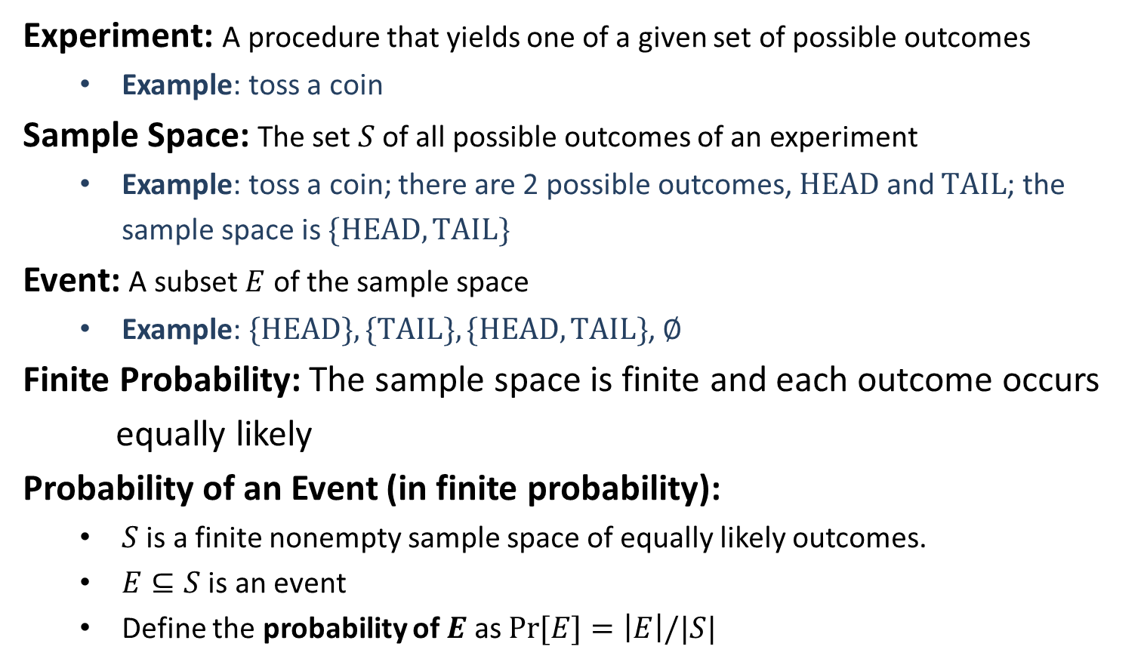
Finite Probability
Experiment: A procedure that yields one of a given set of possible outcomes
Example: toss a coin
Sample Space: The set $S$ of all possible outcomes of an experiment
Example: toss a coin; there are 2 possible outcomes, $HEAD$ and $TAIL$; the sample space is $\{HEAD, TAIL\}$
Event: A subset $E$ of the sample space
Example: $\{HEAD\}, \{TAIL\}, \{HEAD, TAIL\}$, $∅$
Finite Probability: The sample space is finite and each outcome occurs
equally likely
Probability of an Event (in finite probability):
$S$ is a finite nonempty sample space of equally likely outcomes.
$E⊆S$ is an event
Define the probability of $E$ as $\operatorname{Pr}{[E]}=\left|E\right|/|S|$

Slide 8
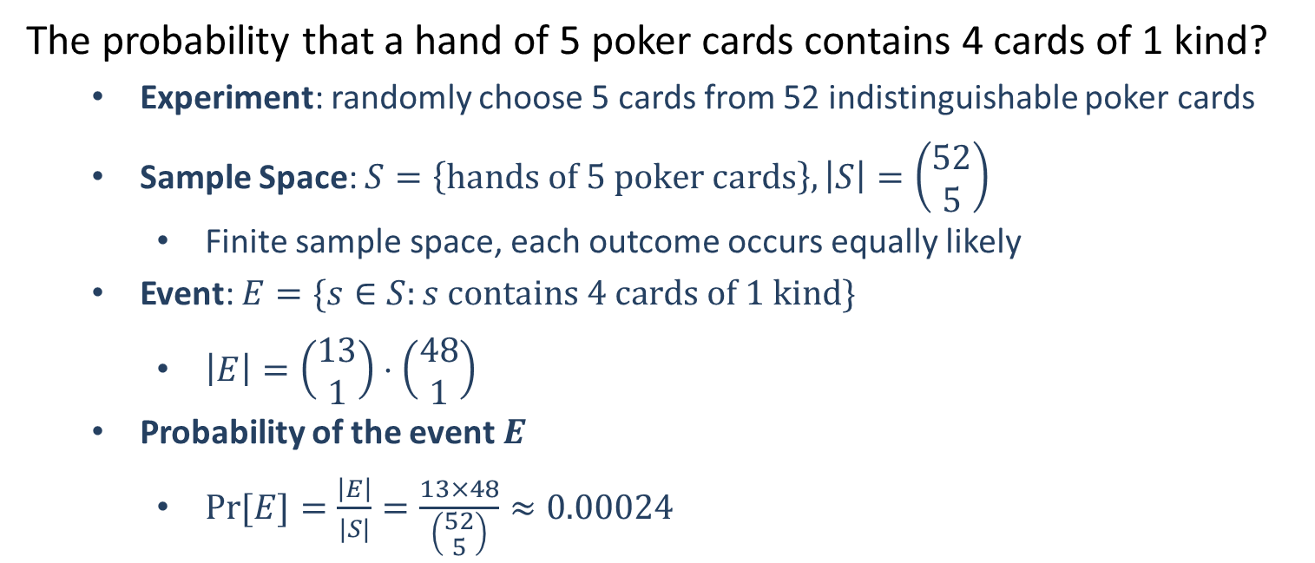
Example
The probability that a hand of 5 poker cards contains 4 cards of 1 kind?
Experiment: randomly choose 5 cards from 52 indistinguishable poker cards
Sample Space: $S=\left\{hands of 5 poker cards\right\}, \left|S\right|=\left(\begin{aligned}52 \\ 5\end{aligned}\right)$
Finite sample space, each outcome occurs equally likely
Event: $E=\{s∈S:s contains 4 cards of 1 kind\}$
$\left|E\right|=\left(\begin{aligned}13 \\ 1\end{aligned}\right)⋅\left(\begin{aligned}48 \\ 1\end{aligned}\right)$
Probability of the event $E$
$\operatorname{Pr}{[E]}=\frac{\left|E\right|}{|S|}=\frac{13×48}{\left(\begin{aligned}52 \\ 5\end{aligned}\right)}≈0.00024$

Slide 9
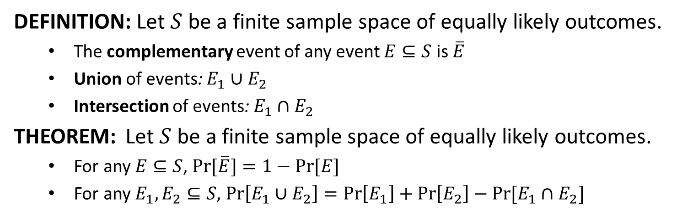
Finite Probability
DEFINITION: Let $S$ be a finite sample space of equally likely outcomes.
The complementary event of any event $E⊆S$ is $\overline{E}$
Union of events: $E_{1}∪E_{2}$
Intersection of events: $E_{1}∩E_{2}$
THEOREM: Let $S$ be a finite sample space of equally likely outcomes.
For any $E⊆S$, $\operatorname{Pr}{[\overline{E}}]=1−Pr⁡[E]$
For any $E_{1}, E_{2}⊆S$, $\operatorname{Pr}\left[E_{1}∪E_{2}\right]=\operatorname{Pr}\left[E_{1}\right]+\operatorname{Pr}\left[E_{2}\right]−Pr⁡[E_{1}∩E_{2}]$

Slide 10
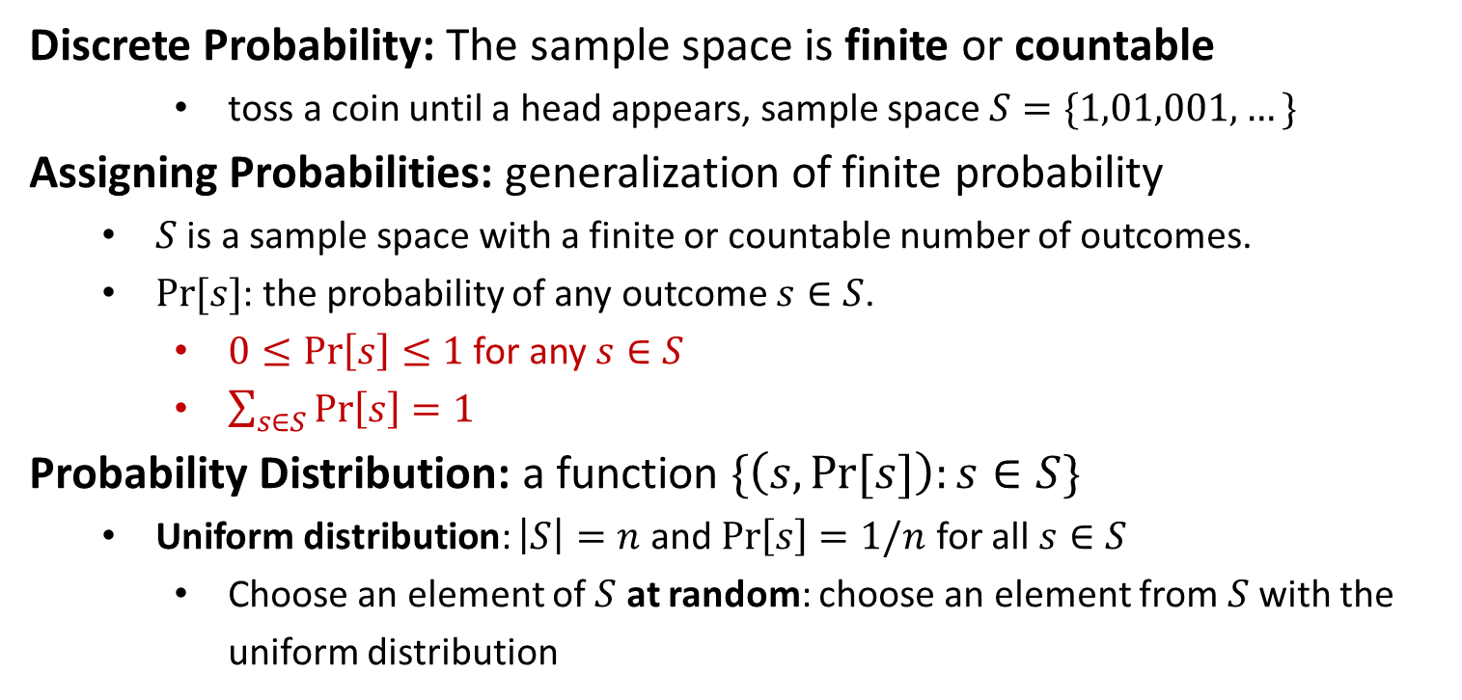
Discrete Probability
Discrete Probability: The sample space is finite or countable
toss a coin until a head appears, sample space $S=\{1,01,001,…\}$
Assigning Probabilities: generalization of finite probability
$S$ is a sample space with a finite or countable number of outcomes.
$Pr⁡[s]$: the probability of any outcome $s∈S$.
$0≤\operatorname{Pr}\left[s\right]≤1$ for any $s∈S$
$\sum_{s∈S}{\operatorname{Pr}\left[s\right]=1}$
Probability Distribution: a function $\{\left(s,\operatorname{Pr}{[s]}\right):s∈S\}$
Uniform distribution: $\left|S\right|=n$ and $\operatorname{Pr}\left[s\right]=1/n$ for all $s∈S$
Choose an element of $S$ at random: choose an element from$S$with the uniform distribution

Slide 11
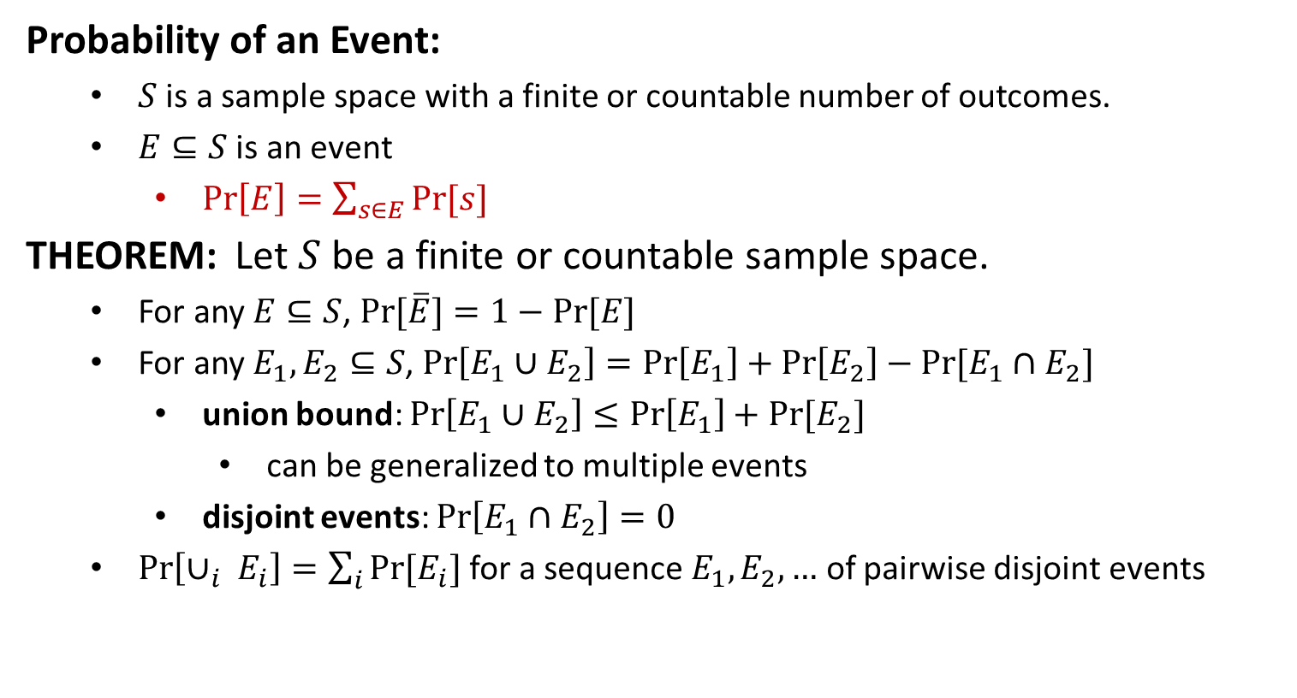
Discrete Probability
Probability of an Event:
$S$ is a sample space with a finite or countable number of outcomes.
$E⊆S$ is an event
$\operatorname{Pr}\left[E\right]=\sum_{s∈E}{Pr⁡[s]}$
THEOREM: Let $S$ be a finite or countable sample space.
For any $E⊆S$, $\operatorname{Pr}{[\overline{E}}]=1−Pr⁡[E]$
For any $E_{1}, E_{2}⊆S$, $\operatorname{Pr}\left[E_{1}∪E_{2}\right]=\operatorname{Pr}\left[E_{1}\right]+\operatorname{Pr}\left[E_{2}\right]−Pr⁡[E_{1}∩E_{2}]$
union bound: $\operatorname{Pr}\left[E_{1}∪E_{2}\right]≤\operatorname{Pr}\left[E_{1}\right]+Pr⁡[E_{2}]$
can be generalized to multiple events
disjoint events: $\operatorname{Pr}\left[E_{1}∩E_{2}\right]=0$
$\operatorname{Pr}\left[∪_{i} E_{i}\right]=\sum_{i}{Pr⁡[E_{i}]}$for a sequence $E_{1},E_{2},…$ of pairwise disjoint events

Slide 12
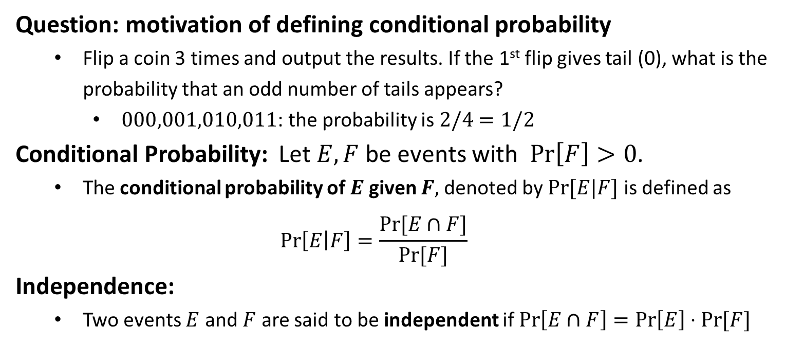
Conditional Probability
Question: motivation of defining conditional probability
Flip a coin 3 times and output the results. If the 1st flip gives tail (0), what is the probability that an odd number of tails appears?
$000,001,010,011$: the probability is $2/4$ $=1/2$
Conditional Probability: Let $E,F$ be events with $\operatorname{Pr}\left[F\right]>0$.
The conditional probability of $E$ given $F,$ denoted by $Pr⁡[E|F]$ is defined as
$$\operatorname{Pr}\left[E | F\right]=\frac{Pr⁡[E∩F]}{Pr⁡[F]}$$
Independence:
Two events $E$ and $F$ are said to be independent if $\operatorname{Pr}\left[E∩F\right]=\operatorname{Pr}\left[E\right]⋅Pr⁡[F]$

Slide 13
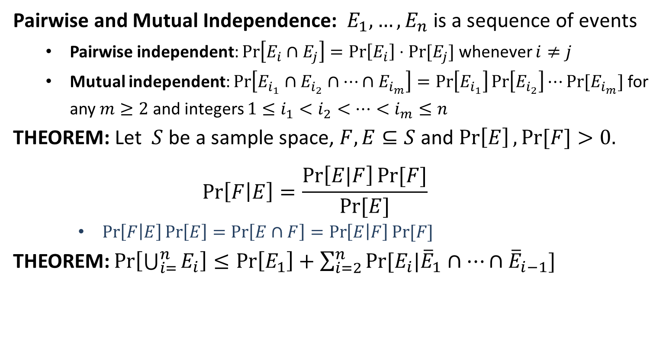
Conditional Probability
Pairwise and Mutual Independence: $E_{1},…,E_{n}$ is a sequence of events
Pairwise independent: $\operatorname{Pr}\left[E_{i}∩E_{j}\right]=\operatorname{Pr}\left[E_{i}\right]⋅Pr⁡[E_{j}]$ whenever $i≠j$
Mutual independent: $\operatorname{Pr}\left[E_{i_{1}}∩E_{i_{2}}∩⋯∩E_{i_{m}}\right]=\operatorname{Pr}\left[E_{i_{1}}\right]\operatorname{Pr}\left[E_{i_{2}}\right]⋯Pr⁡[E_{i_{m}}]$ for any $m≥2$ and integers $1≤i_{1}<i_{2}<⋯<i_{m}≤n$
THEOREM: Let $S$ be a sample space, $F,E⊆S$ and $\operatorname{Pr}\left[E\right],Pr⁡[F]>0.$
$$\operatorname{Pr}\left[F | E\right]=\frac{\operatorname{Pr}\left[E|F\right]Pr⁡[F]}{Pr⁡[E]}$$
$\operatorname{Pr}\left[F | E\right]\operatorname{Pr}\left[E\right]=\operatorname{Pr}\left[E∩F\right]=\operatorname{Pr}\left[E | F\right]Pr⁡[F]$
THEOREM: $\operatorname{Pr}\left[\bigcup_{i=}^{n}{E_{i}}\right]≤\operatorname{Pr}\left[E_{1}\right]+\sum_{i=2}^{n}{Pr⁡[E_{i}|{\overline{E}}_{1}∩⋯∩{\overline{E}}_{i−1}]}$

Slide 14
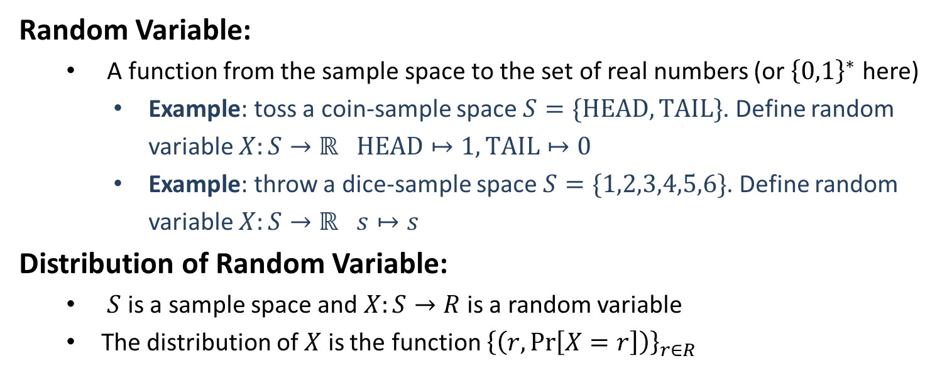
Random Variable
Random Variable:
A function from the sample space to the set of real numbers (or ${\left\{0,1\right\}}^{∗}$ here)
Example: toss a coin-sample space $S=\{HEAD, TAIL\}$. Define random variable $X:S→ℝ$ $HEAD↦1, TAIL↦0$
Example: throw a dice-sample space $S=\{1,2,3,4,5,6\}$. Define random variable $X:S→ℝ$ $s↦s$
Distribution of Random Variable:
$S$ is a sample space and $X:S→R$ is a random variable
The distribution of $X$ is the function ${\left\{\left(r,\operatorname{Pr}\left[X=r\right]\right)\right\}}_{r∈R}$

Slide 15
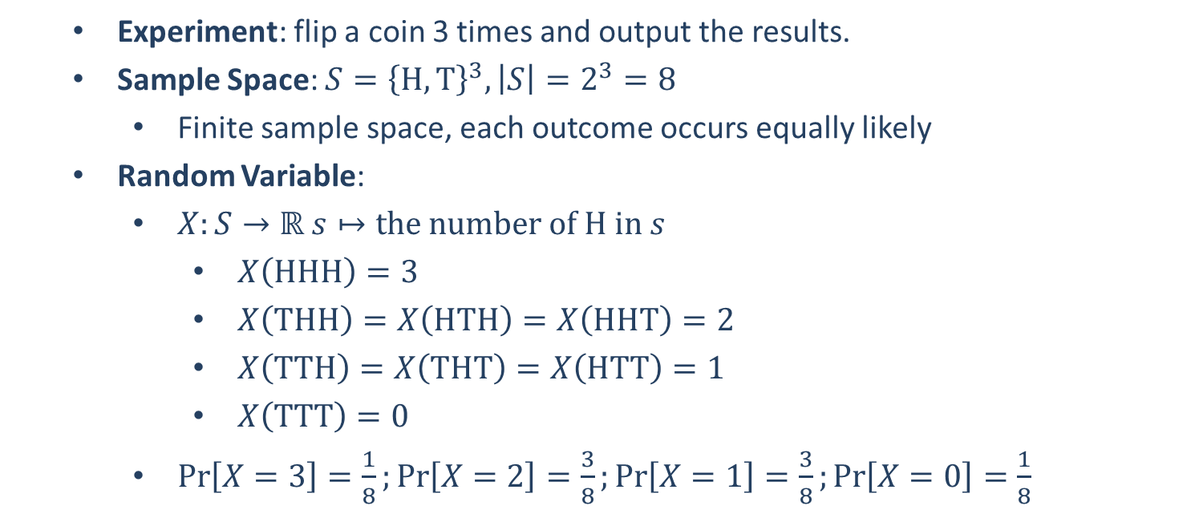
Example
Experiment: flip a coin 3 times and output the results.
Sample Space: $S={\left\{H,T\right\}}^{3}, \left|S\right|=2^{3}=8$
Finite sample space, each outcome occurs equally likely
Random Variable:
$X:S→ℝ s↦the number of H in s$
$X\left(HHH\right)=3$
$X\left(THH\right)=X\left(HTH\right)=X\left(HHT\right)=2$
$X\left(TTH\right)=X\left(THT\right)=X\left(HTT\right)=1$
$X\left(TTT\right)=0$
$\operatorname{Pr}\left[X=3\right]=\frac{1}{8};\operatorname{Pr}\left[X=2\right]=\frac{3}{8};\operatorname{Pr}\left[X=1\right]=\frac{3}{8};\operatorname{Pr}\left[X=0\right]=\frac{1}{8}$

Slide 17

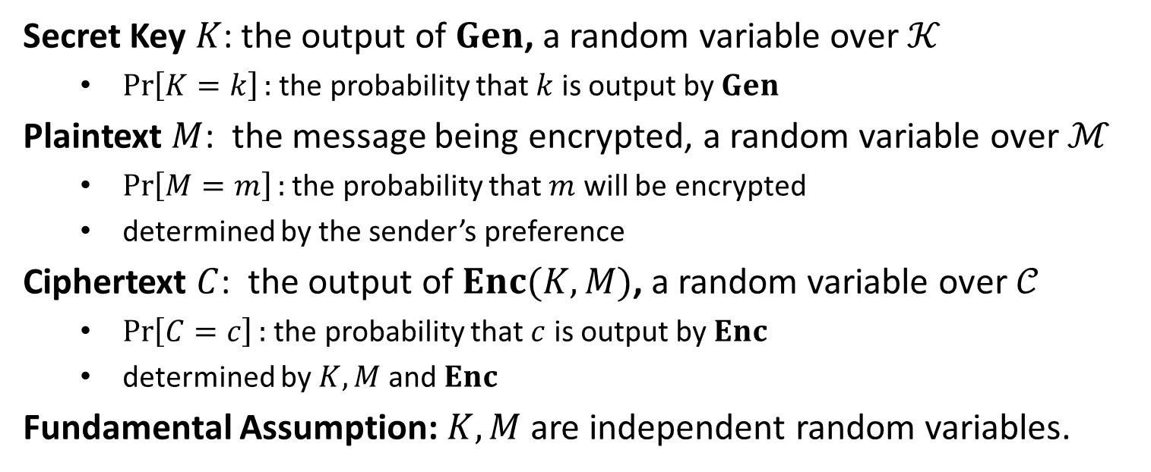
Distributions on $𝒦,ℳ,𝒞$
Secret Key $K$: the output of $Gen$, a random variable over $𝒦$
$\operatorname{Pr}\left[K=k\right]:$ the probability that $k$ is output by $Gen$
Plaintext $M$: the message being encrypted, a random variable over $ℳ$
$\operatorname{Pr}\left[M=m\right]:$ the probability that $m$ will be encrypted
determined by the sender’s preference
Ciphertext $C$: the output of $Enc(K,M)$, a random variable over $𝒞$
$\operatorname{Pr}\left[C=c\right]:$ the probability that $c$ is output by $Enc$
determined by $K,M$ and $Enc$
Fundamental Assumption: $K,M$ are independent random variables.

Slide 18
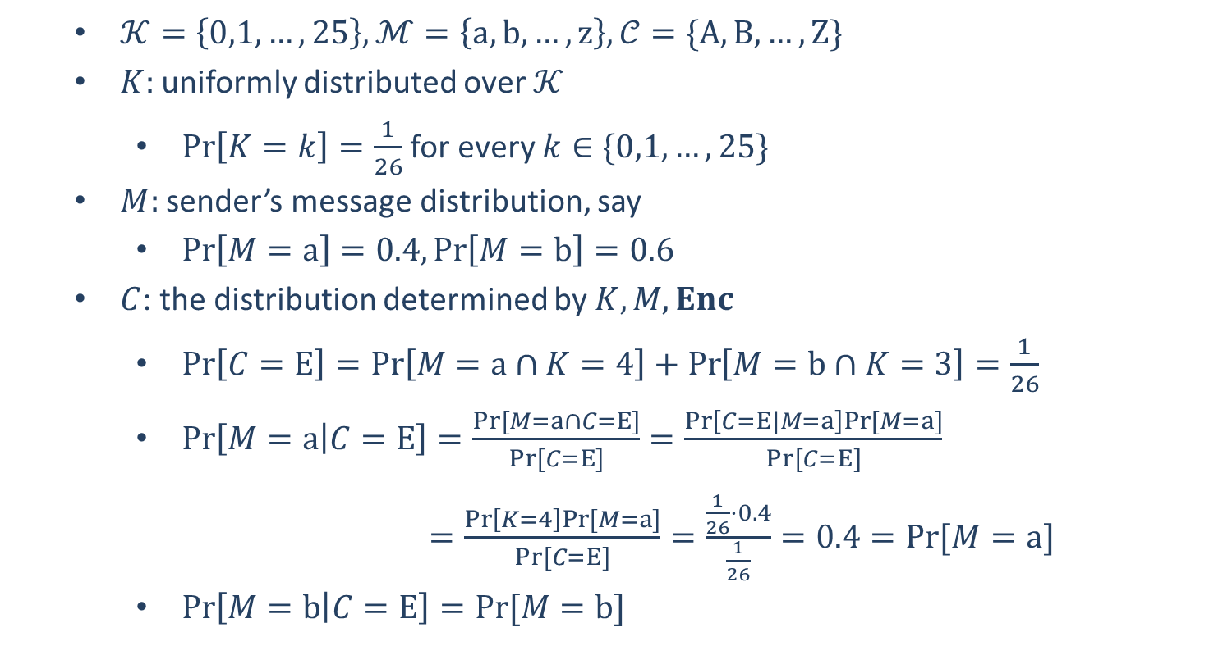
Example: Shift Cipher
$𝒦=\left\{0,1,…,25\right\}, ℳ=\left\{a,b,…,z\right\}, 𝒞=\{A,B,…,Z\}$
$K:$uniformly distributed over $𝒦$
$\operatorname{Pr}\left[K=k\right]=\frac{1}{26}$ for every $k∈\{0,1,…,25\}$
$M:$ sender’s message distribution, say
$\operatorname{Pr}\left[M=a\right]=0.4,\operatorname{Pr}\left[M=b\right]=0.6$
$C$: the distribution determined by $K,M, Enc$
$\operatorname{Pr}\left[C=E\right]=\operatorname{Pr}\left[M=a∩K=4\right]+\operatorname{Pr}\left[M=b∩K=3\right]=\frac{1}{26}$
$\operatorname{Pr}\left[M=a | C=E\right]=\frac{Pr⁡[M=a∩C=E]}{Pr⁡[C=E]}=\frac{\operatorname{Pr}\left[C=E|M=a\right]Pr⁡[M=a]}{Pr⁡[C=E]}$
$=\frac{\operatorname{Pr}\left[K=4\right]Pr⁡[M=a]}{Pr⁡[C=E]}=\frac{\frac{1}{26}⋅0.4}{\frac{1}{26}}=0.4=Pr⁡[M=a]$
$\operatorname{Pr}\left[M=b | C=E\right]=Pr⁡[M=b]$

